Slide 1

Final Project Glove for Deaf Group: D28 Online
Mohammad Abdullah Mossa

Slide 2
Agenda:
Problem Description.
Flowchart.
Coding.
Proteus Simulation.

Slide 3
Problem Description
As sign language is used by deaf people, the goal of this project is to create an embedded system that can translate the sign language into words using an LCD.
Flex sensors are normally used to give different voltages (different resistances) when the fingers move. These voltages are mapped and translated into words.

Slide 4
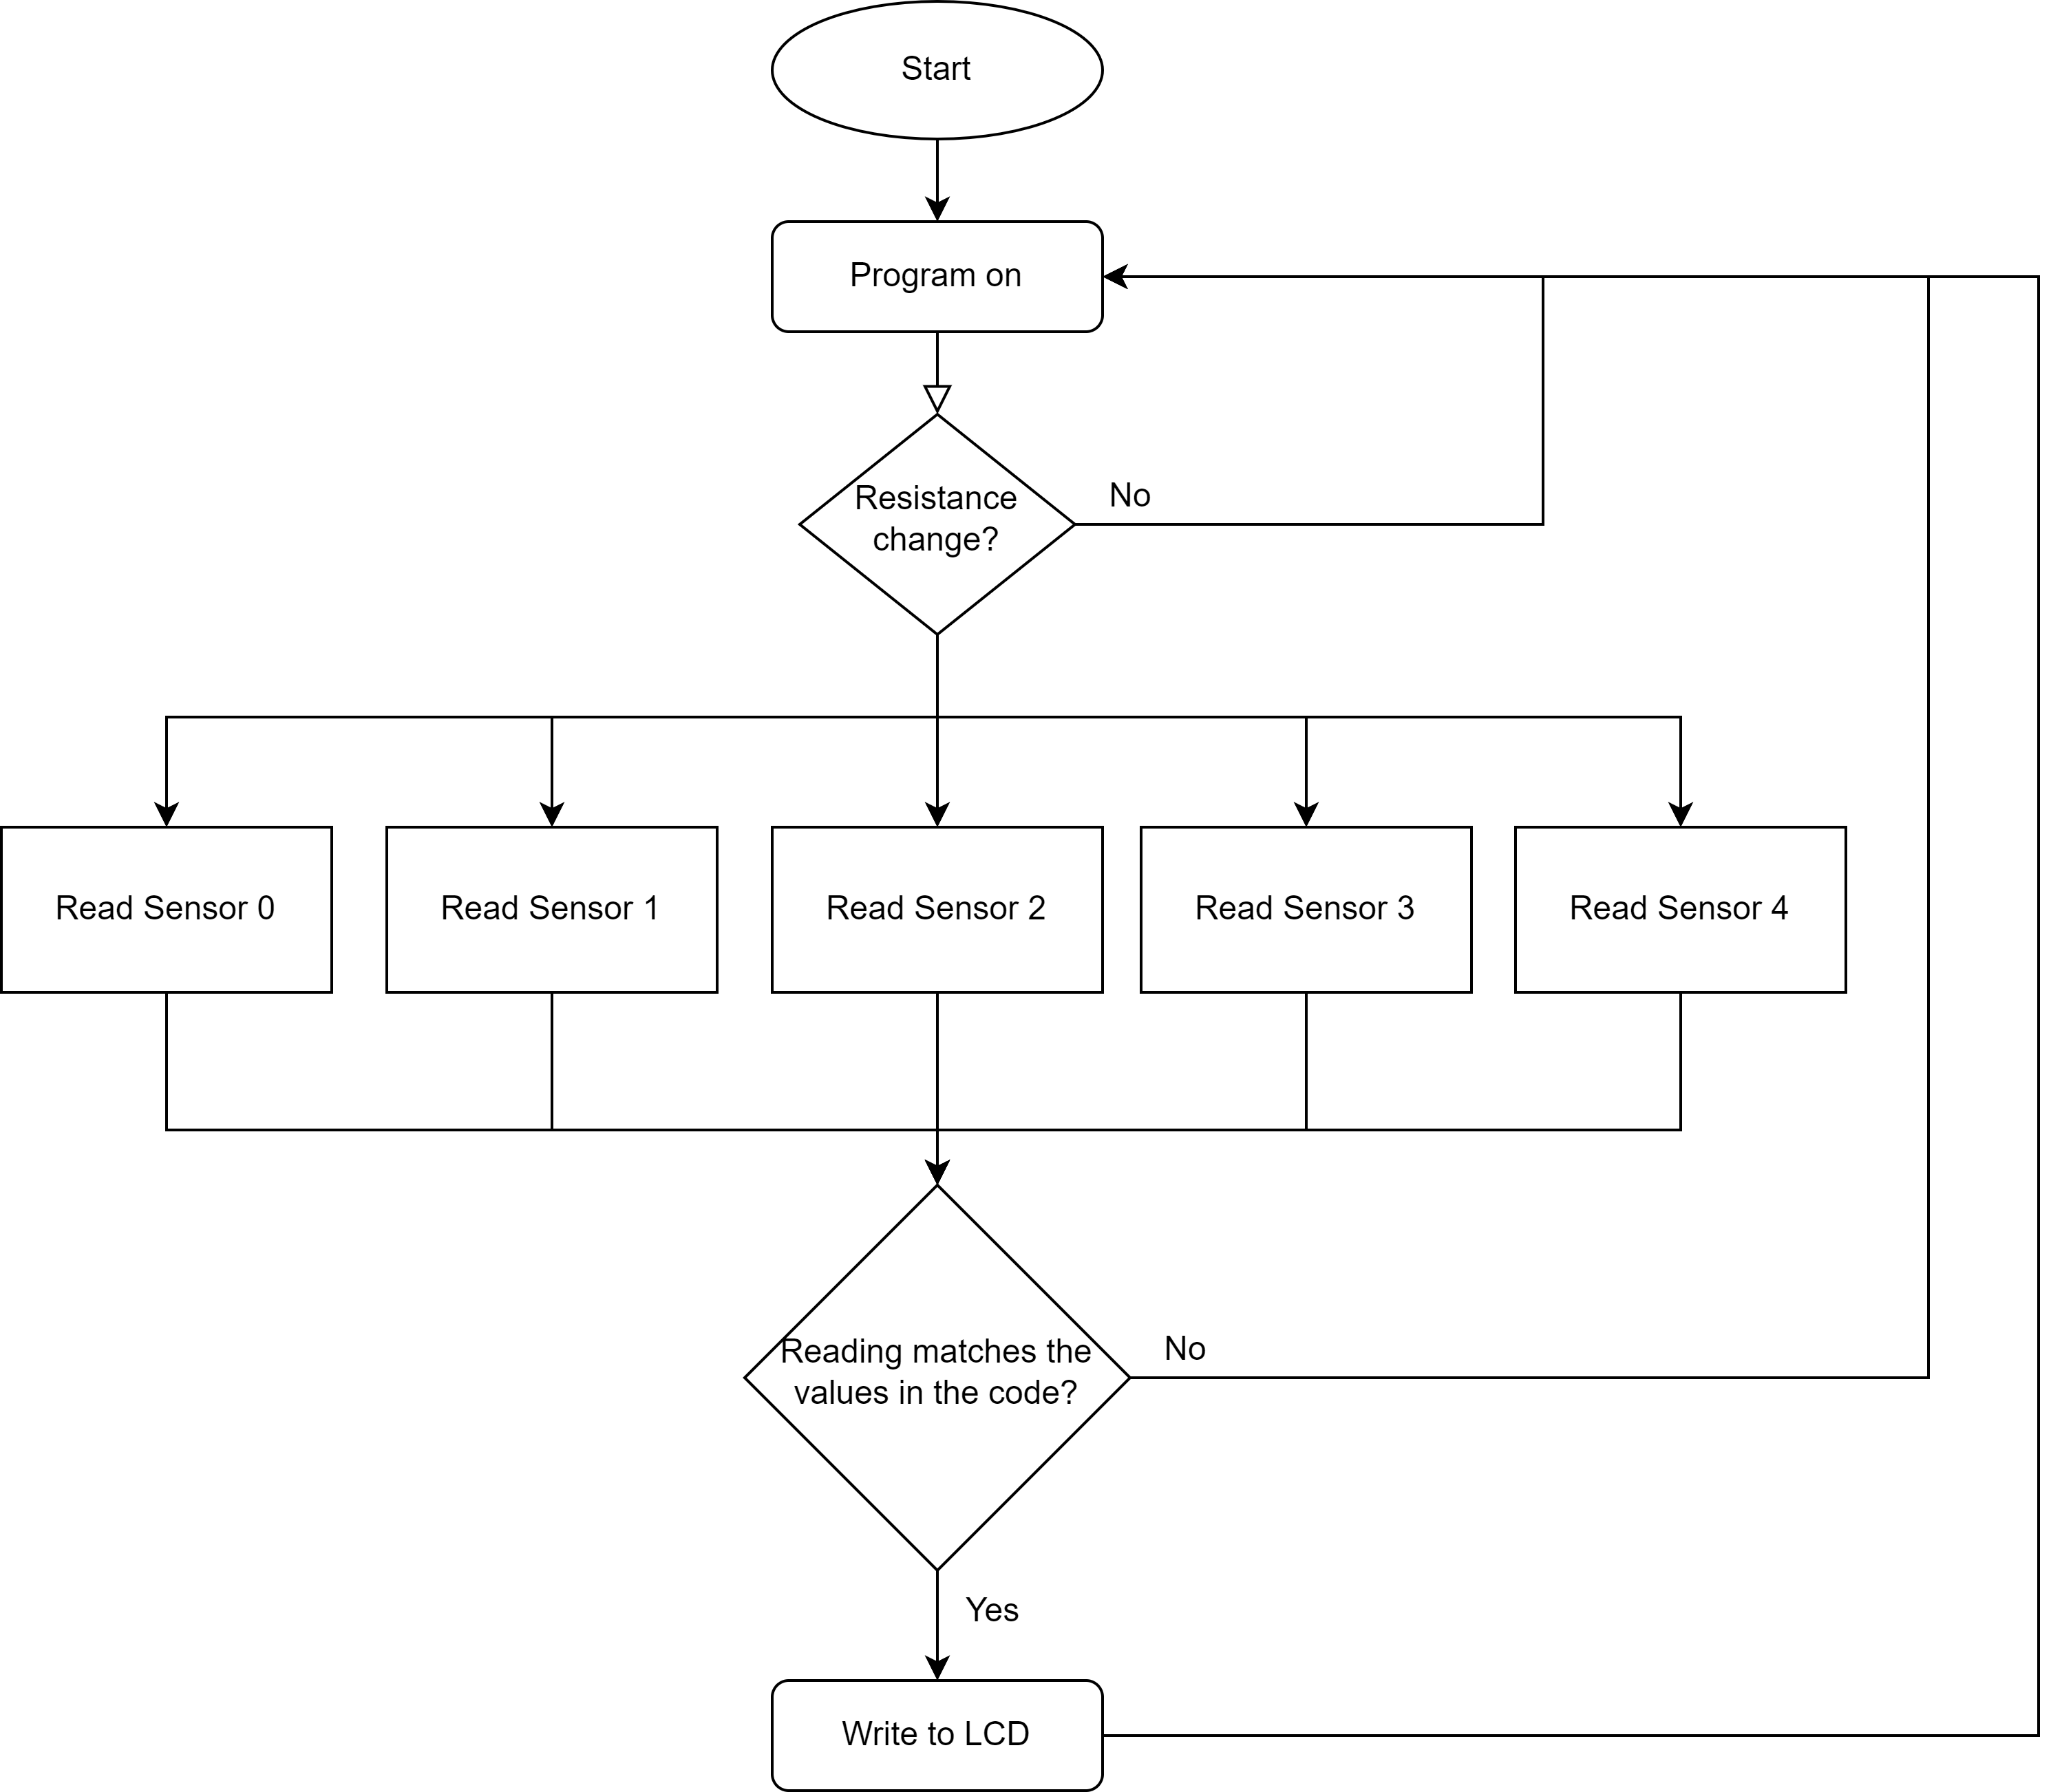
Flowchart

Slide 5
Coding
Layered Archeticture.
App layer: Bit Math, Main, and STD files.
Hal layer: Flex sensor (potentiometers), and LCD.
Mcal layer: ADC and DIO.
Link: https://github.com/mmossa1/Amit-Project---Glove-for-deaf

Slide 6
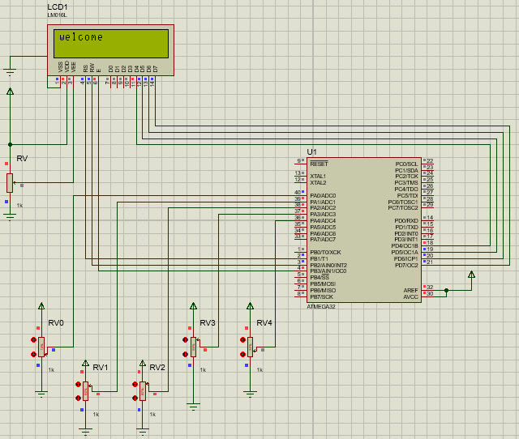
Proteus Simulation
Link to video: https://drive.google.com/file/d/1TPjTi2k9SAxhGY2pf5H3-zVJXBJyQlv8/view?usp=sharing

